Slide 1
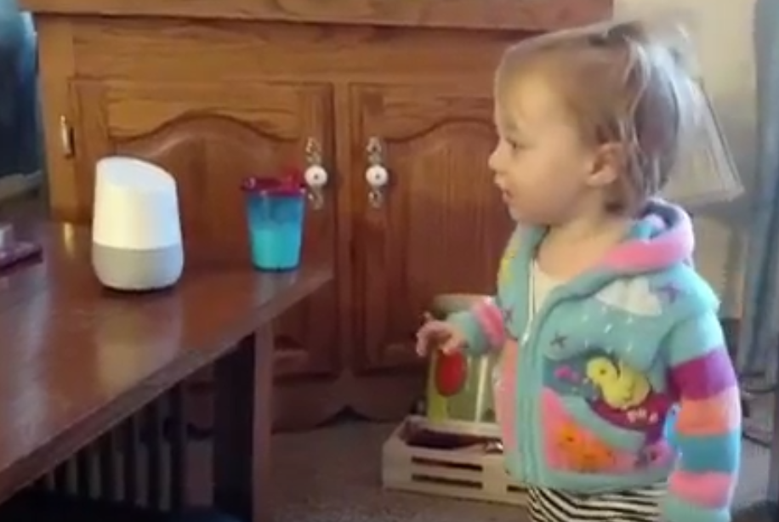
Deep Learning for NLP
Jay Urbain, PhD
Professor, Electrical Engineering and Computer Science Department
Milwaukee School of Engineering
urbain@msoe.edu

Slide 2
What is Natural Language Processing
Why is NLP hard?
NLP Vocabulary
Text Classification
Word embeddings
Network architectures: MLP, CNN, RNN
TensorFlow, Keras, Pandas
TOPICS: Classification

Slide 3
WHAT IS NATURAL LANGUAGE PROCESSING (NLP)?

Slide 4

WHAT IS A NATURAL LANGUAGE PROCESSING (NLP)?
“Natural language processing (NLP) is an area of computer science and artificial intelligence concerned with the interactions between computers and human (natural) languages, in particular how to program computers to process and analyze large amounts of natural language data. “
Wikipedia
GOAL: for computers to process or “understand” natural language in order to perform tasks that are useful such as question answering
Add structure to unstructured text
Full understanding for now is unsolved

Slide 5
NLP APPLICATIONS
Keyword search
Text classification
Named entity recognition
Machine translation
Question answering, chatbot dialog systems
Much more...

Slide 6
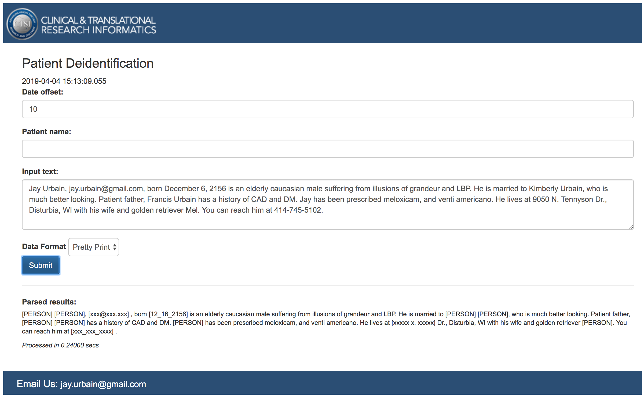
https://cis.ctsi.mcw.edu/deid/

Slide 7
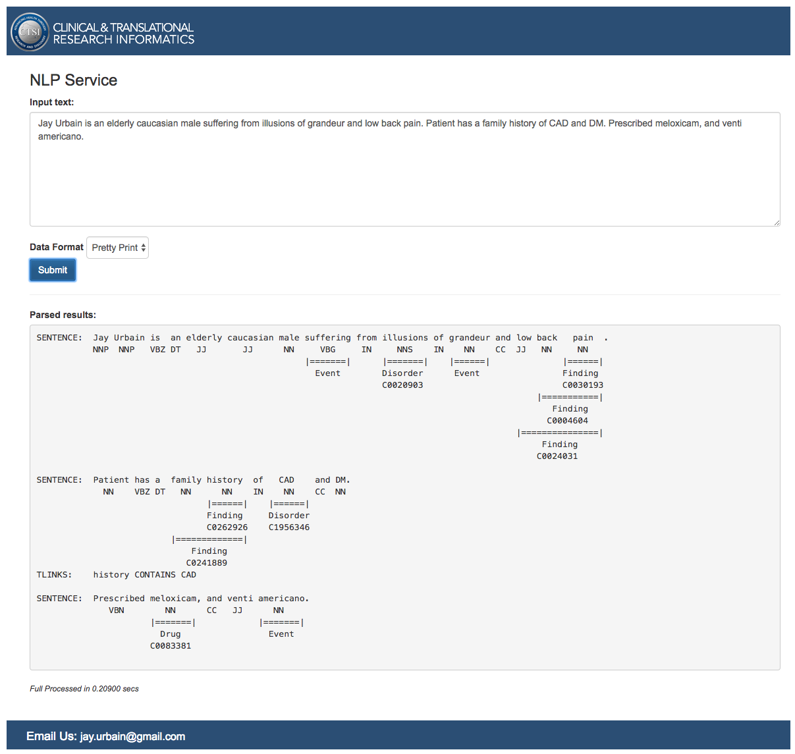
https://cis.ctsi.mcw.edu/nlp/
Clinical Named
Entity Identification

Slide 8
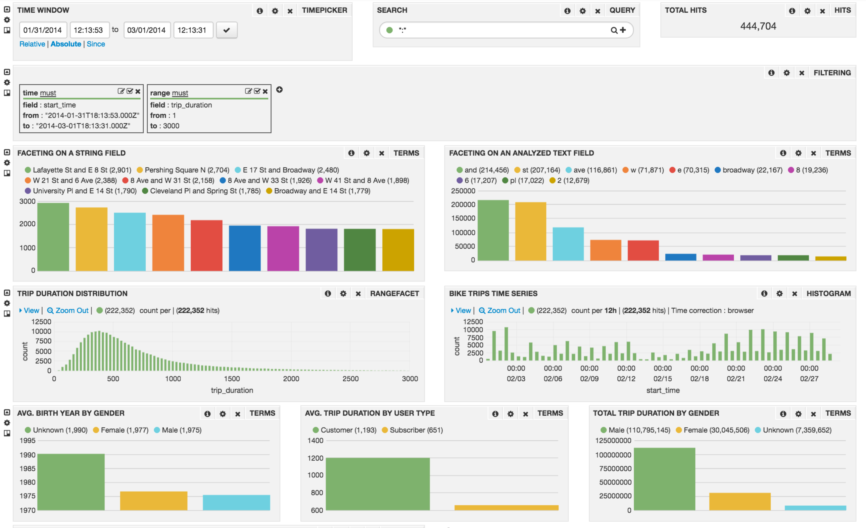
Search driven discovery: aggregating statistics from named entities

Slide 9
Prologue – Medical Record Machine “Translation” - work with Bradley Crotty, MD
COLONOSCOPY Procedure Note. Date of Procedure: [1_21_2016]. Primary Physician: [PERSON] [PERSON] [PERSON], MD. Attending Physician: [PERSON] [PERSON], MD. Fellow:None. Indications: Colon cancer screening for family history of colon cancer Colon cancer screening for family history of polyps.. Previous COLONOSCOPY: Yes. Date: [8_16_2007]. Medications Administered: Agents given by the anesthesia service during MAC. Procedure Details: The patient was placed in the left lateral position and monitored continuously with ECG tracing, pulse oximetry monitoring and direct observations. Medications were administered incrementally over the course of the procedure to achieve an adequate level of moderate sedation. After anorectal examination was performed, the Olympus CF H180 was inserted into the rectum and advanced under direct vision to the terminal ileum. The procedure was considered not difficult. During withdrawal examination, the final quality of the prep was good.. Bowel Prep Scale Right Colon: Grade 2 (minor amount of residual staining, small fragments of stool, and/or opaque liquid, but mucosa of colon segment is seen well) . Bowel Prep Scale for Transverse Colon: Grade 3 (entire mucosa of colon segment seen well, with no residual staining, small fragments of stool, or opaque liquid) . Bowel Prep Scale for Left Colon: Grade 2 (minor amount of residual staining, small fragments of stool, and/or opaque liquid, but mucosa of colon segment is seen well) Additional rinsing and suctioning (600 ml) were necessary to obtain adequate views. A careful inspection was made as the colonoscope was withdrawn, which did include a retroflexed evaluation of the rectum. Findings and interventions are described below. Appropriate photo documentation was obtained. Overall [PATIENT] L [PATIENT] did tolerate the procedure well, without undue discomfort, hypotension or desaturation. At the completion of the procedure she was transferred from the endoscopy suite to be recovered in the FSC observation area per protocol and was discharged when criteria was met. After adequate recovery from sedation, she was discharged to home, with appropriate plans for follow up in place. Scope in time: 0741 Cecum reached time: 0747. Scope out time: 0759. Findings:. Findings for the Anorectal: No mass. Findings for the Terminal Ileum: Normal ileal mucosa. Findings for the Cecum: Normal mucosa. Findings for the Ascending Colon: Normal mucosa. Findings for the Transverse Colon: 1 polyp 2 mm in size, sessile, removed by cold biopsy and sent for pathology. Findings for the Descending Colon: Normal mucosa. Findings for the Sigmoid Colon: Normal mucosa. Findings for the Rectum: 2 polyps 4 mm in size, sessile, removed by hot biopsy and sent for pathology Hypertrophied anal PAPillae Small anal fissure. Interventions: 1 polyp removed by cold biopsy 2 polyps removed by hot biopsy. Complications: None. Adverse Events: No. Impression: 1. Multiple, 3 colon polyps, removed by cold biopsy and hot biopsy and sent for pathology 2. Family history of colon cancer 3. Family history of polyps 4. Hypertrophied anal PAPillae 5. Anal fissure 6. Otherwise normal COLONOSCOPY to the terminal ileum. Recommendations: ? Avoid aspirin and NSAIDs for 14 days ? Await pathology results ?. Dietary recommendations: High fiber diet. ? Anusol HC or similar ointment for discomfort form anal fissure/PAPillitis ?. Repeat COLONOSCOPY in 5 years ? For the patient's next COLONOSCOPY, a 4 liter, split dose prep should be used. In addition, the patient should start a low residue diet two days before the exam and be on a clear liquid diet the day before the exam. ? Would use large caliber colonoscope ? Follow up with primary care physician. Histopathologic Diagnosis: A. Transverse colon polyp, polypectomy: ? Tubular adenoma. B. Rectal polyps, polypectomy: ? Tubular adenoma (x1). ? Hyperplastic polyp (x1).. Qualify for GI Quality project: Yes #@Screening@# Extent of Examination: #@Complete@# Pathology: #@Adenomatous change@# Appendiceal orifice Ileum Rectal polyp Rectal polyp Anal PAPillitis and small fissure @ 6 o'clock [PERSON] [PERSON] [PERSON], MD, FACP
Translation
Date of procedure:
1_21_2016
Indications for colon cancer screening:
Family history of polyps
Complications:
The procedure was considered not difficult
Findings for the transverse colon:
1 polyp 2mm
Tubular adenoma
Hyperplastic polyp
NSAIDS should be avoided:
14 days
Recommendations:
High fiber diet

Slide 10
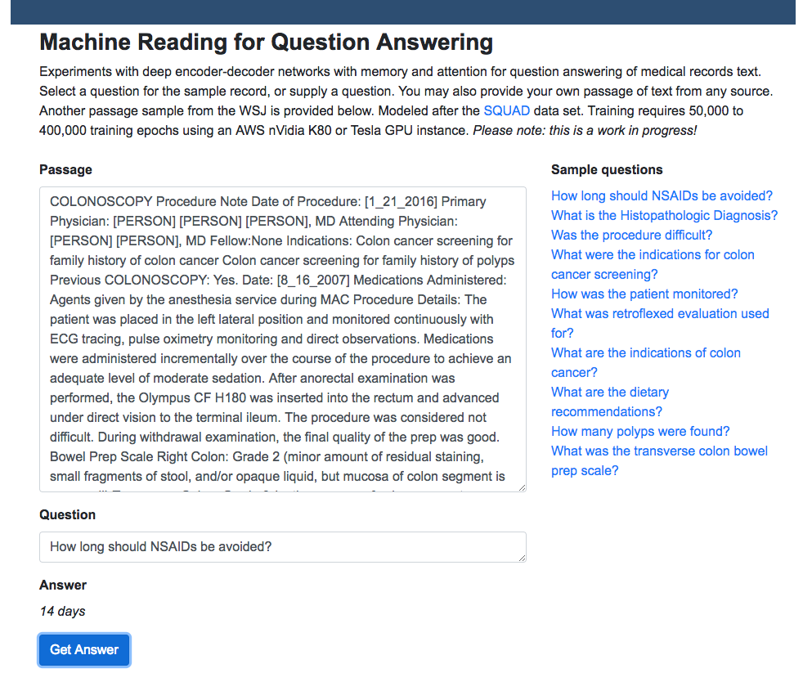
Question Answering
http://ec2-54-163-221-189.compute-1.amazonaws.com:8080/

Slide 11
WHY IS NLP HARD? … and why Deep Learning may help

Slide 12
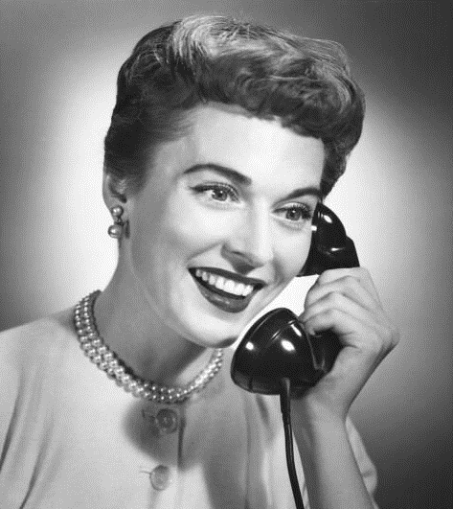

Language: the ultimate UI
Where is A Bug’s Life playing in Milwaukee?
A Bug’s Life is playing at the Downer Theater.
When is it playing there?
It’s playing at 2pm, 5pm, and 8pm.
OK. I’d like 1 adult and 2 children for the first show.
How much would that cost?
But we need domain knowledge, discourse knowledge, world knowledge
Notes:
After all, language is really the ultimate user interface – well, maybe not for all applications, maybe not for Photoshop.
But wouldn’t it be incredibly useful if you could have an interaction like this?
But this is well beyond what we can do today. Take a moment to consider what makes this hard.
Let me focus just on the problem of reference resolution – figuring out what various expressions refer to.
We need to recognize that “A Bug’s Life” refers to a movie, and “Milwaukee” refers to a town.
We need to figure out that “it” refers to “A Bug’s Life”, “there” refers to “the Downer Theater”, and “that” refers to the tickets.
And we need to understand that people don’t generally buy adults and children, and therefore that the user is referring to buying adult and child tickets.
We also need to figure out that “the first show” refers to 2pm, because 2pm is earlier than 5pm and 8pm.
And that’s just for reference resolution. So this is really quite challenging. [>]
Domain knowledge – Bug’s life is a movie, Milwaukee is a city
Discourse – the meaning of language within a context, e.g., knowing how a conversation fits together
World knowledge – the knowledge that we already have and can draw on in a conversation

Slide 13

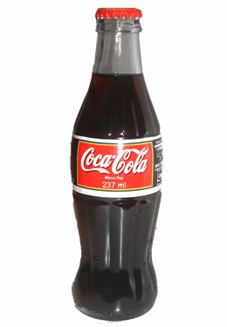


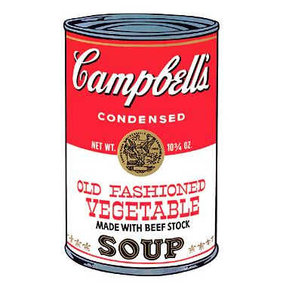
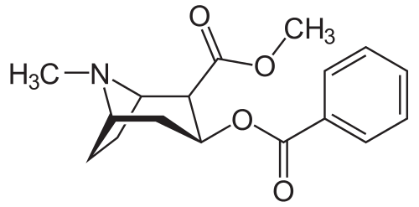
Meanings and expressions
Big obstacle: relation between meanings and expressions is not one-to-one
soda
Biebster
soft drink
pop
beverage
Coke
Many expressions, many meanings …
Notes:
One big obstacle is that the relation between meanings and expressions is not one-to-one. Far from it.
First, one meaning can be expressed in many different ways – so this thing can be described as “soda”, or a “soft drink”, or “pop”.
And conversely, one expression can have many different meanings – so “pop” can refer to the Biebster, or your Dad, or even Pop Art. [>]

Slide 14


Syntactic & semantic ambiguity
syntactic ambiguity
S
S
VP
VP
semantic ambiguity
PP
NP NP
NP NP
Fruit flies like a banana
Fruit flies like a banana
[“like” is a remarkable word: it can be used as a noun, verb, adverb,
adjective, preposition, particle, conjunction, or interjection.]
photos from worth1000.com
Notes:
So we have two possible readings, represented here pictorially. And we have two different kinds of ambiguity.
First, there is semantic ambiguity.
“Flies” could be a noun, meaning insects, or it could be a verb, meaning travel by air.
And “like” could be a verb, meaning love, or it could be a preposition, meaning similar to.
[“like” is a remarkable word: it can be used as a noun, verb, adverb, adjective, preposition, particle, conjunction, or interjection.]
And then we also have a syntactic ambiguity.
It could be that “fruit flies” is the subject, and “like a banana” is the predicate.
Or it could be that “fruit” is the subject, and “flies like a banana” is the predicate.
These kind of ambiguities show up all over the place, and as humans, we’re so good at resolving them that usually we don’t even notice them consciously.
But sometimes, unintentional ambiguities produce a quite comic effect. [>]

Slide 15
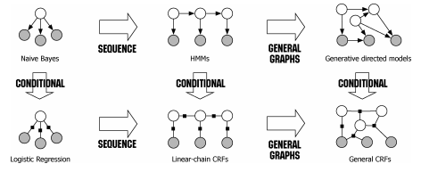
Traditional NLP use “shallow” statistical machine learning models: HMM, MEMM, CRF
http://homepages.inf.ed.ac.uk/csutton/publications/crftut-fnt.pdf

Slide 16
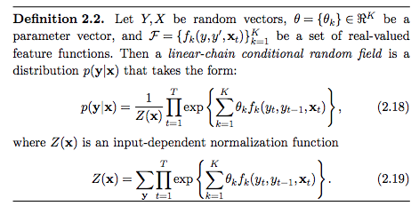
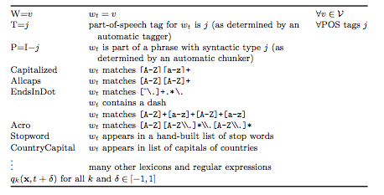
Traditional Models: HMM, MEMM, CRF
http://homepages.inf.ed.ac.uk/csutton/publications/crftut-fnt.pdf
Linear chain CRF for sequence class, Named entity CRF features
Custom solutions for each domain, and for each application.
Difficulty capturing long-range dependencies, context, and semantics

Slide 17

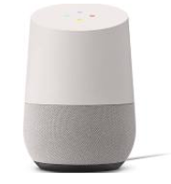

NLP: With deep Learning, reality is getting closer to vision
Ok Google, what’s my commute?
Siri, play Stompy the Bear
Alexa, re-order Thai Peanut Sauce
Notes:
Now if you’re in AI, you’ve probably been excited about AI since you were about … eight years old. I know I have.
For years, we’ve all been dreaming about having computers that can talk to us.
The ability to use language is an essential ingredient of the AI vision,
and the quest to endow computers with this ability has been the ultimate driver of NLP research for more than 50 years.
This dream is ultimately the reason why I’m standing here today. [>]

Slide 18
NLP VOCABULARY

Slide 19
VOCABULARY
token - A unit of text, typically a word. Could also be:
Group of words like "New York"
Sub-word like "mega" in "megabyte"
Letter like "m"
tokenizing - Creating tokens, representing tokens as a distinct number
document - Sequence of tokens
Could be whole book or a tweet
Classify each document as having a positive or a negative sentiment
corpus - A set of documents
We'll use a corpus containing movie reviews since each document is paired with a rating indicating sentiment

Slide 20
VOCABULARY
n-grams - adjoining sequence of n tokens (words)
Sometimes referred to as shingles
sentiment analysis - evaluate mood of n-grams
Determine the attitude / emotion of text
tf-idf = term frequency * inverse document frequency
Numerical statistic intended to reflect significance of a word to a document in a corpus
Popular term-weighting schemes
TF increases each time a word appears in a document
IDF decreases each time a word appears in a corpus

Slide 21
TEXT CLASSIFICATION

Slide 22
TEXT CLASSIFICATION
We will be training several neural network models for text classification.
In text classification, documents (or segments of text) are assigned to different categories.
For example, categories could be positive or negative sentiment, different authors, different topics, or different writing styles.
Interesting problems like ambiguity arise:
"To sanction" can mean "to permit" or "to punish.”
Berkshire Hathaway vs. Anne Hathaway
Capturing context at different hierarchical levels is key. Deep Learning can help us!

Slide 23
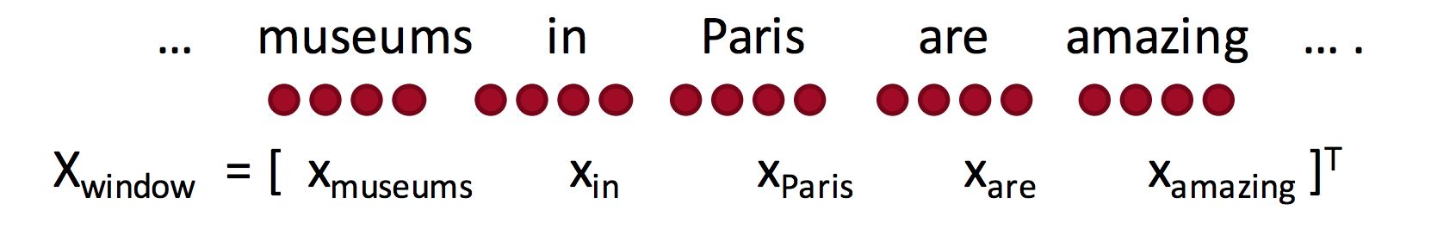
WINDOW TEXT CLASSIFICATION
Classify Paris in the context of this sentence with window of length 2:

Slide 24
EMBEDDINGS

Slide 25
WORKING WITH TEXT
Neural networks don’t take raw text as input. Only numeric tensors.
Vectorizing text is the process of transforming text into numeric tensors. This can be done in multiple ways:
Segment text into words, and transform each word into a vector.
Segment text into characters, and transform each character into a vector.
Extract n-grams of words or characters, and transform each n-gram into a vector.
Apply categorical transformation:
One-hot encoding
Word embedding

Slide 26
ONE-HOT ENCODING
Words are categorical, they have no ordinal relationship. So they can’t just be numerically encoded.
For each word:
Numerically encode each word: {red:0, green:1, blue:2}
Generate vector of zeros the length of all possible words/categories
Set the index value for the word in the vector
red, green, blue
1, 0, 0
0, 1, 0
0, 0, 1

Slide 27
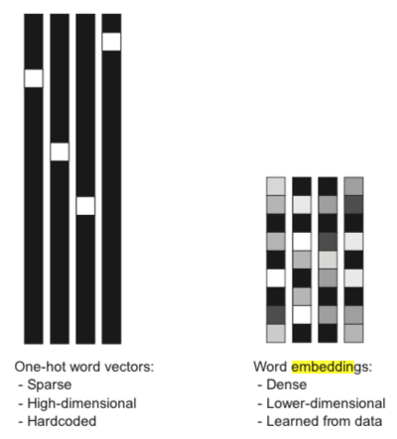
WORD EMBEDDINGS
One-hot results in sparse vector representation (mostly zeros, hi dimensions).
Word embeddings provide dense vector representations.
Idea is to “embed” words into a lower-dimensionality space.
The dimensions of this space are typically defined by word context, i.e., semantically similar words are embedded near each other.
Popular algorithms:
PMI,Word2Vec: Skip-gram or CBOW, GLoVE, FastTect

Slide 28
The Distributional Hypothesis (Firth, 1957)
‘You can tell a word by the company it keeps’
The cat sat on the mat
The dog sat on the mat
The elephant sat on the mat
The quickly sat on the mat
Notes:
A key insight into how to represent textual data (specifically, individual words or lexemes) to an algorithm comes from Linguistics. In 1957, Firth proposed his Distributional Hypothesis. In simple words, the DH means that similar words tend to appear in the same places.
In this example, given a set of context words that appear before and after a target word (colored in either green or red), we see that the appropriate target words are all animals. Obviously, the word quickly does not fit into the context, primarily because it is an adverb while the context stipulates a noun (or a phrase that acts as a noun, aptly named a noun phrase). However, the word pen – which is a noun – would also not be appropriate in this context. This time the reason is semantic rather than syntactic – and it is this property of the DH that we would like to exploit in giving our input representation a-priori ‘intelligence’.

Slide 29
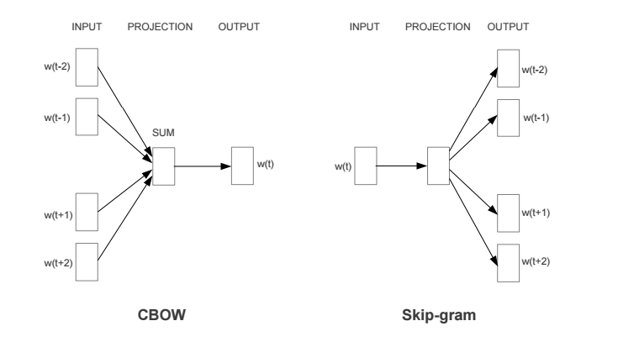
Embeddings: Word2Vec
CBOW model predict missing word (focus word) using context (surrounding words).
Skip gram model predicts context based on the word in focus.
Context is a fixed number of words to the left and right of the word in focus.
Maximize average log probability of context words co-occurring with focus words.
Notes:
Predictive models learn their vectors in order to improve their predictive ability of Loss(target word | context words; Vectors), i.e. the loss of predicting the target words from the context words given the vector representations. In word2vec, this is cast as a feed-forward neural network and optimized as such using SGD, etc.

Slide 30
Properties of embeddings
They are dense: 0.53, 0.2, -1.2, ….
They are low dimensional: (typically 50 <= d <= 300)
Embed domain semantics:
`king’ - `man` + `woman` ≈ `queen`
`paris` - `france` + `spain` ≈ `madrid`
Generalize easily!

Slide 31
Properties of embeddings (cont.)
They are used as input across a variety NLP tasks (transfer learning!):
…
…
…
…
…
…
Word 1
Word n
Word 1
Word n
|V|
|V|
d
d
Total #
of input parameters:
n * |V|
>>
n * d
Notes:
Once embeddings have been trained, they can be used as the input for NLP tasks such as classification or recommendation.
In this example, we compare the input size in the BoW representation vs. the embeddings representation:
In the former case, we have n words * |V| (size of vocabulary) input neurons. For large vocabularies, this can easily outnumber – by a large margin – the number of input neurons required for d (embedding dimensionality) * n words.

Slide 32
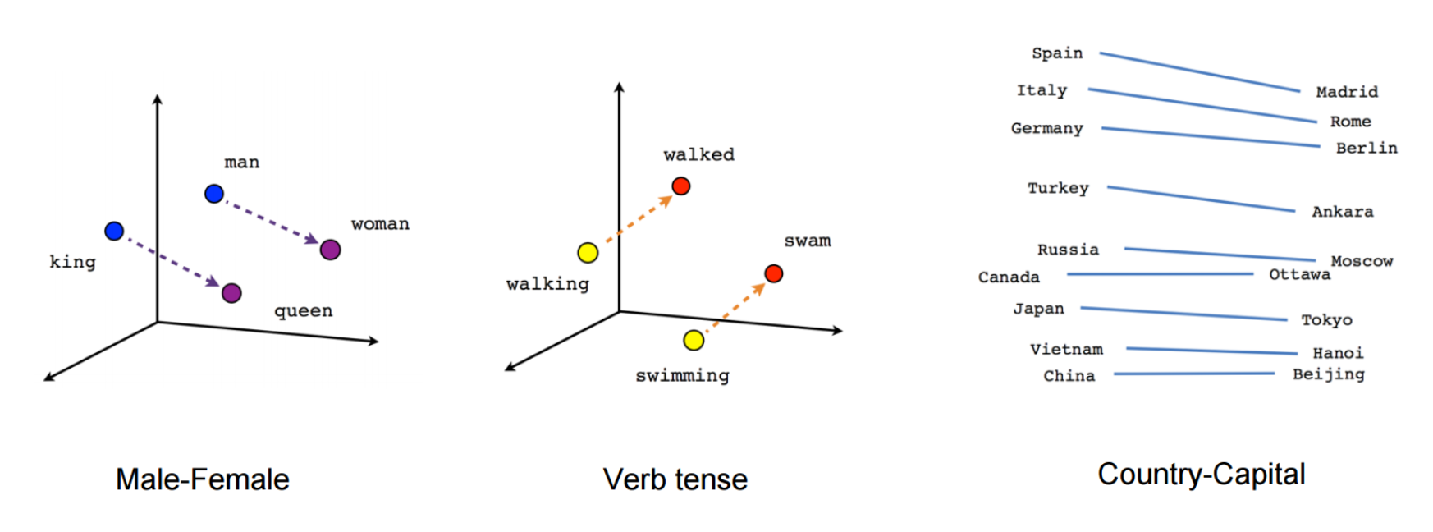
https://www.tensorflow.org/tutorials/representation/word2vec

Slide 33
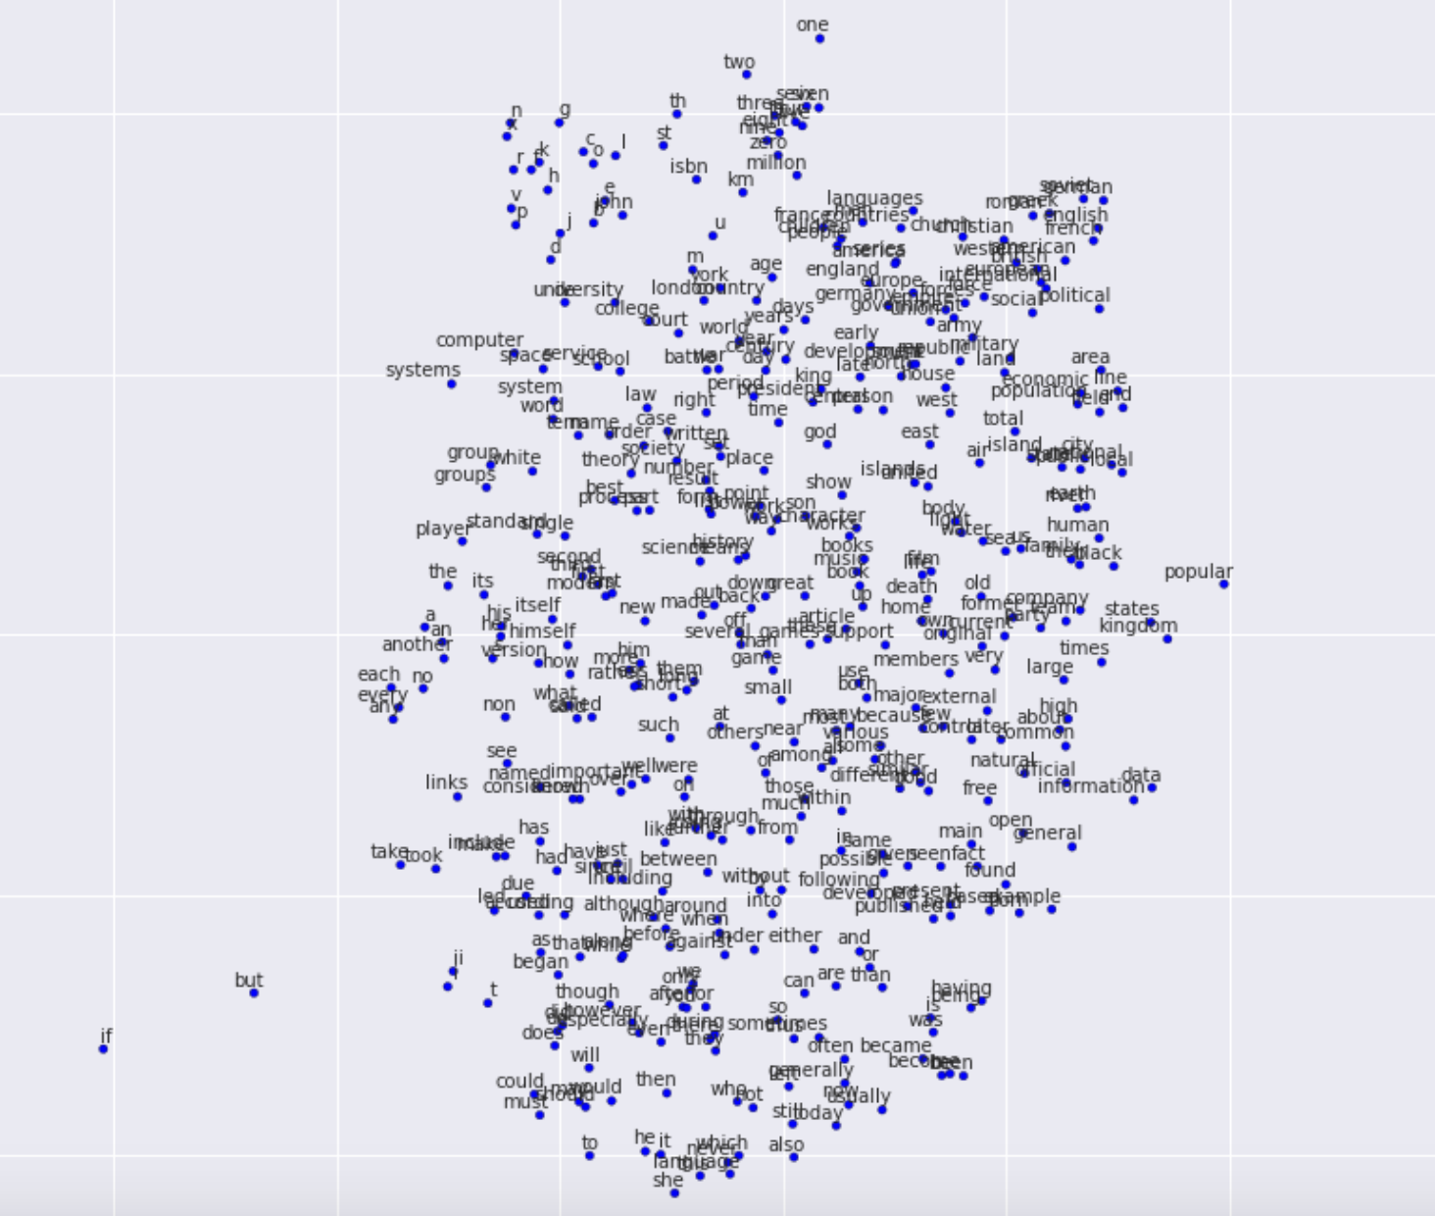

Slide 34
USING WORD EMBEDDINGS
Learn an Embedding
Use KERAS embedding layer
2. Reuse an Embedding
Download pre-trained word vectors

Slide 35
TENSORFLOW, KERAS, PANDAS

Slide 36
WHAT IS TENSORFLOW?
Created by Google, tensorflow.org
“Open source software library for machine intelligence”
Available on GitHub
Flexibility—express your computation as a data flow graph
If you can express it in TF syntax you can run it
Portability—CPUs and GPUs, workstation, server, mobile
Language options—Python, C++, R
Performance—Tuned for performance on CPUs and GPUs
TensorFlow, the TensorFlow logo and any related marks are trademarks of Google Inc.

Slide 37
KERAS
Developed by Francois Chollet, Google Research Engineer
Modular neural network written in Python
Runs on TensorFlow, CNTK, and Theano (no longer supported)
Keras library allows for easy and fast prototyping
Runs on GPUs and CPUs
Now packaged with latest TensorFlow

Slide 38
#### Keras
from keras.models import Sequential
from keras.layers import Dense
model = Sequential()
# Stacking layers by using .add():
model.add(Dense(units=64, activation='relu', input_dim=100))
model.add(Dense(units=10, activation='softmax'))
model.compile(loss='categorical_crossentropy’, optimizer='sgd’, metrics=['accuracy'])
model.fit(x_train, y_train, epochs=5, batch_size=32)
More here:
https://keras.io/

Slide 39
PANDAS
Open-source, BSD-licensed project
Fast and efficient DataFrame object for data manipulation with integrated indexing
DataFrames used in this lab
Ideal for neural networks
Contains tools for reading and writing data between in-memory data structures and different formats such as:
CSV and text files – used in this lab
Microsoft Excel
SQL databases
HDF5

Slide 40
NETWORK ARCHITECTURE – MLP

Slide 41
MULTI-LAYER PERCEPTRON
MLP = Multi-layer Perceptron
Traditional fully connected feed-forward network
Also called dense network
Fixed size input

Slide 42
LAB DISCUSSION / OVERVIEW

Slide 43
LAB OVERVIEW
Perform text classification for sentiment analysis
Classify each document into one of two different sentiments:
"positive“ or "negative“
Components of lab include:
Pandas
TensorFlow and Keras
MLP, CNN, RNN/LSTM

Slide 44
LAB PROCESS
Data Preparation:
Load libraries, data and visualize / evaluate data
Divide dataset between Training, Validation and Test sets
Implement TF-IDF using Keras
Create matrix for labels

Slide 45
LAB PROCESS
Build and evaluate 3 network architectures:
Design simple neural network
Visualize network architecture
Train model
Compare test, validation and training accuracy
Attempt to improve the model
Complete the Simple Multi-Layer Perceptron Model portion of the lab.
Stop when you reach One-Dimensional Convolutional Neural Network Model, we’ll regroup.

Slide 46
TRAINING TERMINOLOGY

Slide 47
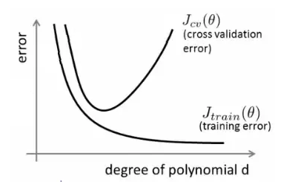
Overfitting and Underfitting
Overfitting refers to a model that fits the training data too well.
Your model begins to “memorize” the training data and becomes less likely to generalize to unseen test data.
Validation error >> training error
Correct by either simplifying model, generalizing model, or getting additional data.
Underfitting refers to large training error. Increase complexity of model.

Slide 48
Learning terminology
Learning rate –- weighting of dE/dW
Decay rate – rate to reduce learning rate
Decay steps: number of steps to execute before changing learning rate
Number of epochs – number of times to cycle through the input data
Batch size: number of samples that going to be propagated through the network

Slide 49
NETWORK ARCHITECTURE – CNNs

Slide 50
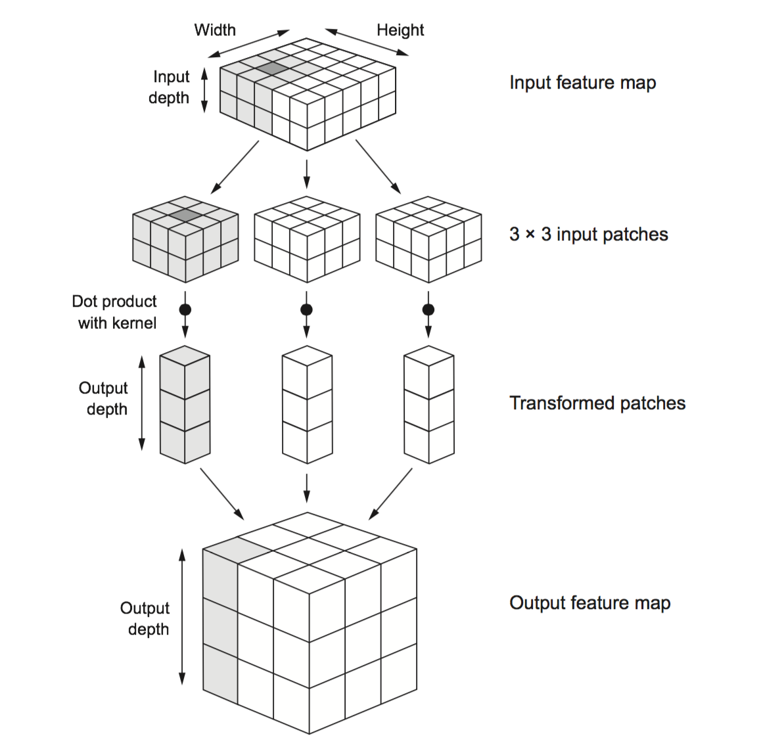
Convolution Neural Network (CNN)
A CNN is made up of Layers: convolution, pooling, fully connected.
Each layer transforms an input 3D volume to an output 3D volume.
Learns local parameters in input space using a stack of (e.g., 3x3) convolution filters
The patterns the filters learn are translation invariant.
Learn spatial hierarchies of patterns by adding conv. and pooling layers. E.g., edges, shapes, motifs.
FRANÇOIS CHOLLET, 2018
Notes:
This makes convnets data efficient when processing images (because the visual world is fundamentally translation invariant): they need fewer training samples to learn representations that have generalization power.
○ They can learn spatial hierarchies of patterns (see figure 5.2). A first convolution layer will learn small local patterns such as edges, a second convolution layer will learn larger patterns made of the features of the first layers, and so on. This allows convnets to efficiently learn increasingly complex and abstract visual con- cepts (because the visual world is fundamentally spatially hierarchical).
Input feature map:, e.g., normalized image. For input images, depth typically corresponds to color channels.
Patches: stack of 3x3 filters. Applied to each pixel in input. Output depth is the number of stacked filters.

Slide 51
LAB PROCESS
Build and evaluate the One-Dimensional Convolutional Neural network architectures
Design simple neural network
Visual network architecture
Train model
Compare test, validation and training accuracy
Attempt to improve the model
If you finish early, complete the RNN model.

Slide 52
NETWORK ARCHITECTURE – RNNS / LSTMS

Slide 53
RECURRENT NEURAL NETWORK
RNN = Recurrent Neural Network
Similar to traditional feed-forward network
RNNs include previous output state
Limited to looking back only a few steps due to vanishing gradient
Errors are backpropagated through time
Inputs from previous time steps get exponentially down weighted and are eventually driven to zero

Slide 54
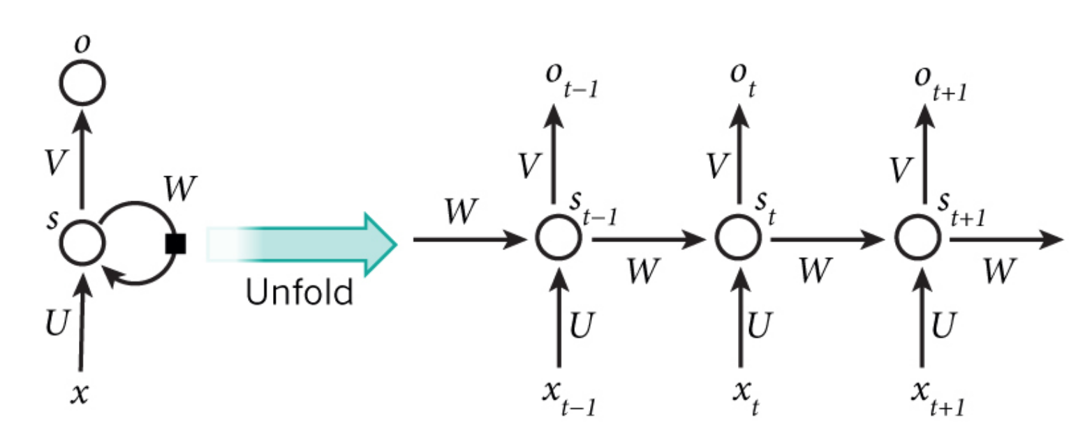
Recurrent Neural Network (RNN)
RNNs have connections between units along a sequence.
RNN’s use the hidden state from the last time step and the input at the current step to make predictions.
Allow RNN’s can capture dynamic temporal behavior for a time sequence.

Slide 55
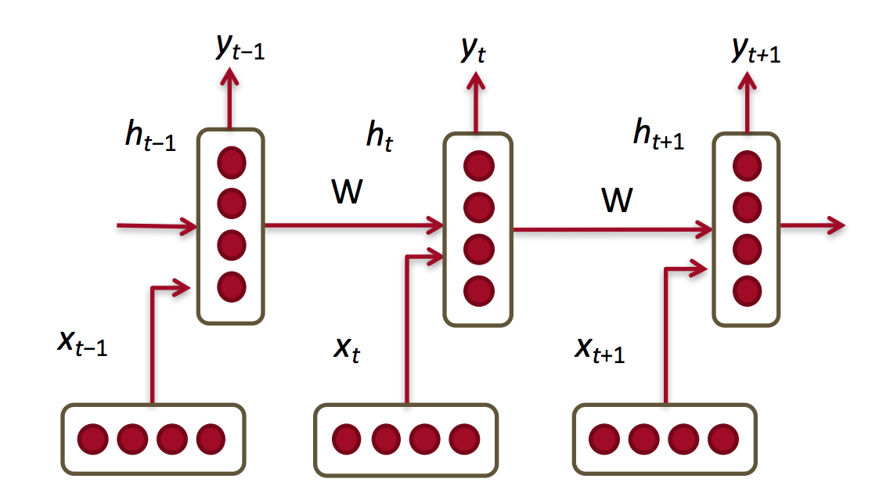
RECURRENT LAYERS
RNNs share the weights between the time steps
Condition the neural network on all previous words
(and all document in the end)
RAM requirement only scales with number of timesteps

Slide 56
LONG SHORT TERM MEMORY
LSTM = Long Short Term Memory
Variant of RNN
No (less) of a vanishing gradient problem
LSTMs can learn “very deep” tasks that require memories of words N words ago

Slide 57
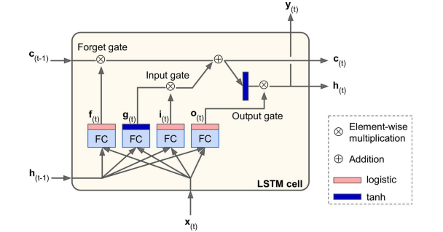
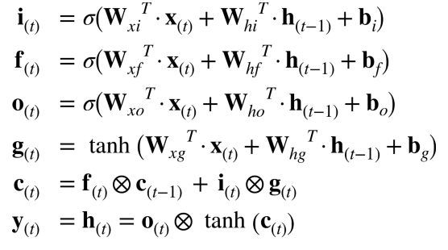
Long Short Term (LSTM) Cell
Notes:
Regular RNN’s are notoriously difficult to train. Because of the multiple timesteps, error gradients often tend to either shrink (‘vanish’) or grow (‘explode’) exponentially. This means that vanilla RNNs have difficulty with long sequences such as the ones we need for dealing with long text sequences.
A modification to the standard RNN is the Long Short-Term Memory (LSTM) cell, which overcomes many of the issues just mentioned. Essentially, it is a set of multiple neurons known as gates along with a memory cell. At each timestep, the cell receives input (x) along with the cell contents (c) and hidden state (h) from the previous timestep. The gates have the following functions:
Forget gate – what parts of the memory cell should be ‘forgotten’
Input gate – what parts of the input should be applied to the memory cell
Output gate - what parts of the memory cell should be exposed in the output of the cell
The new hidden state and memory cell state are then propagated to the next time step. The parameters are learned as usual using BPTT.

Slide 58
LAB DISCUSSION / OVERVIEW

Slide 59
LAB PROCESS
Build and evaluate the LSTM network architecture
Design simple neural network
Visual network architecture
Train model
Compare test, validation and training accuracy
Attempt to improve the model
This can be a take-home exercise.

Slide 60
References
Neural Responding Machine for Short-Text Conversation (2015-03)
A Neural Conversational Model (2015-06)
A Neural Network Approach to Context-Sensitive Generation of Conversational Responses (2015-06)
The Ubuntu Dialogue Corpus: A Large Dataset for Research in Unstructured Multi-Turn Dialogue Systems (2015-06)
Building End-To-End Dialogue Systems Using Generative Hierarchical Neural Network Models (2015-07)
A Diversity-Promoting Objective Function for Neural Conversation Models (2015-10)
Attention with Intention for a Neural Network Conversation Model (2015-10)
Improved Deep Learning Baselines for Ubuntu Corpus Dialogs (2015-10)
A Survey of Available Corpora for Building Data-Driven Dialogue Systems (2015-12)
Incorporating Copying Mechanism in Sequence-to-Sequence Learning (2016-03)
A Persona-Based Neural Conversation Model (2016-03)
How NOT To Evaluate Your Dialogue System: An Empirical Study of Unsupervised Evaluation Metrics for Dialogue Response Generation (2016-03)

Slide 61
Learning resources
Stanford class on deep learning for NLP.http://cs224d.stanford.edu/syllabus.html
Hinton’s Coursera Course. Get it right from the horse’s mouth. He explains things well.
https://www.coursera.org/course/neuralnets
Online textbook in preparation for deep learning from Yoshua Bengio and friends. Clear and understandable.
http://www.iro.umontreal.ca/~bengioy/dlbook/
TensorFlow tutorials.
https://www.tensorflow.org/versions/r0.8/tutorials/index.html

Slide 62
Additional Sources
https://cis.ctsi.mcw.edu/deid/
https://cis.ctsi.mcw.edu/nlp/
https://github.com/jayurbain/machine-learning
https://github.com/jayurbain/ctsi-mcw-deid-service
https://github.com/jayurbain/ctsi-mcw-deid-service

Slide 64
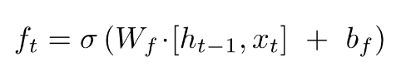
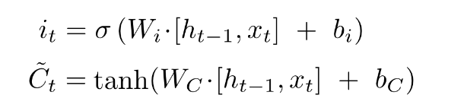
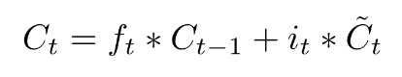
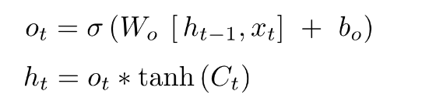
Long Short Term Memory (LSTM)
RNN’s have trouble with long-term dependencies.
Long chain of differentiation when back propagating can cause vanishing gradients
Compose RNN with LSTM cells for "remembering" cell state over arbitrary time intervals
Forget gate – what to forget:
Input gate – what to save:
Update cell state:
Output:
Notes:
The cell is responsible for "remembering" values over arbitrary time intervals; hence the word "memory" in LSTM. Each of the three gates can be thought of as a "conventional" artificial neuron, as in a multi-layer (or feedforward) neural network: that is, they compute an activation (using an activation function) of a weighted sum. Intuitively, they can be thought as regulators of the flow of values that goes through the connections of the LSTM; hence the denotation "gate". There are connections between these gates and the cell.

Slide 65
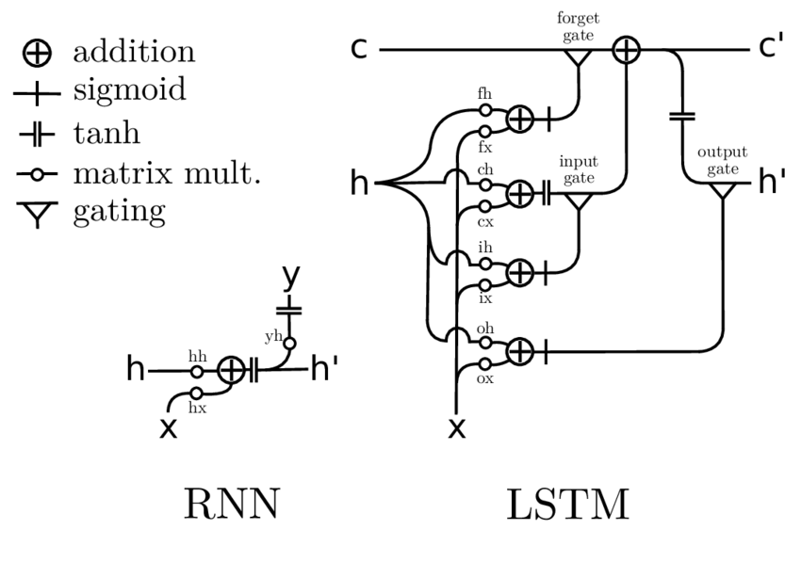
VISUAL COMPARISON - RNN / LSTM

Slide 66
Recurrent Neurons
y
y_{t-1}
y_{t}
y_{t+1}
y_{t+1}
s
s_{t-1}
s_{t}
s_{t+1}
s_{t+2}
x
x_{t-1}
x_{t}
x_{t+1}
x_{t+1}
Unrolling in Time
Notes:
In the previous lab, we encountered Fully-Connected (FC) neural networks. We would either go forward (from layer i to i+1) when propagating information or backwards (from layer i+1 to i) when propagating the error. At no point did we go in a horizontal direction inside the same layer.
Often we wish to use neural networks with sequence inputs or outputs: in other words, our input/output consists of different values at different timesteps. For that, we need to use recurrent neural networks (RNNs). As shown in the example here, at each timestep we have different inputs (the X’s) and different outputs (the y’s). Additionally, we have the state from the previous timestep (the S’s) as input (with the initial state typically being the 0 vector).
The algorithm used to train RNN’s is just the usual backpropagation, applied to subsequent timesteps and hence known as Backpropagation-Through-Time (BPTT).

Slide 67
Slide Dust Bin

Slide 68
LEVELS OF NLP
Phonology - how do we pronounce words
Morphology – how words are formed
Syntax - how the sentences are constructed
Semantics - what does all of this mean
Phonology
Morphology
Syntax
Semantics

Slide 69
WHAT IS A NATURAL LANGUAGE PROCESSING (NLP)?
Natural language processing is a field at the intersection of:
Computer Science
Artificial Intelligence
Linguistics
GOAL: for computers to process or “understand” natural language in order to perform tasks that are useful such as question answering
Add structure to unstructured text
Full understanding for now is unsolved

Slide 70
Why is NLP Hard?
Languages often seem to behave in arbitrary ways and forms
Ambiguity, sarcasm and irony are often not apparent from purely textual information
Domain-specific terms and phrases that may not even be grammatically correct
Deep Learning to the rescue!
Notes:
Dealing with natural language in an algorithmic fashion often poses a number of tough issues:
The grammar and rules of languages often seem arbitrary and random. Consider, for example, the plural form of the word cat vs. that of the word cab. The former is pronounced cats while the latter is pronounced cabz. How then should a speech-to-text system handle plural forms?
Many uses of language depend on the context of a conversation and/or on auditory cues such as stress on a particular word or syllable. Consider ‘would you like this apple?’ vs. ‘would you like this apple?’, where the emphasis is on the bold word. Without these auditory cues and the context, how would an automated system know what the meaning of the sentence is?
Many domains use specific terminology that may not be immediately understood or may even be flat-out grammatically incorrect. Consider the financial term ‘to short a stock’. The meaning is obvious to someone well-versed in the stock market but not so to the layperson. In particular, note that short would normally be considered an adjective while here it is used as a verb. Another example would be ‘my ask of you is …’, where ask – normally a verb – is used as a noun. How can a system differentiate a domain-specific meaning from a grammatical mistake?
Fortunately, Deep Learning can help us. It is meant precisely for these kinds of situations: many ill-defined rules that a human would have a very hard time formulating. Combine this with the fact that massive amounts of textual data are available today in the form of emails, social media posts and articles, and we have a very promising approach for the application of NLP techniques.

Slide 71
Applying ‘Language’ in NLP
The academic field of Linguistics is concerned with the study of natural language and its various aspects – syntax, meaning, sound, etc.
Every human has one or more ‘mother-tongues’ – known technically as L1.
Taking into account various linguistic phenomena can provide many insights into how to program a computer to understand language
In today’s labs, you will encounter ‘echoes’ of this notion – that language can be viewed as software running in our brains!
Notes:
Natural language is studied in the academic discipline of Linguistics, which is taught in many prestigious universities around the world – including MIT and Stanford. In fact, the very well-known scientist Noam Chomsky is a linguist and has made many contributions to both Linguistics and Computer Science. Interestingly, the study of writing and writing systems is not a part of linguistics! Rather, it is studied in the field of Semiotics (think Robert Langdon from the Da Vinci Code by Dan Brown). The two, however, are tightly interlocked – along with ideas from Psychology, Sociology, Neurology and of course, Computer Science and Mathematics.
A key question is why bother. Is a computational approach not sufficient? This is a major discussion point in linguistics and philosophy of language. But the fact remains that we already know quite a bit about how humans ‘process’ language in the brain. And we know that every single human being (barring such pathologies as deep autism) has at least one ‘mother-tongue’. Therefore, we can use this knowledge to help us ‘fine-tune’ our NLP approaches.
Many practitioners of NLP do not apply such knowledge. In the DLI labs, we try to incorporate some of it. We will now see some examples that allow us to think of language in terms of software constructs.

